Slide 1
Lecture 10
Heaps

Slide 2
Main Points
Priority Queue
  Implementations
Heaps
  Why heaps
  Implementation
  Building a heaps using an array
  Operations using heaps
Exercise
Heap sort

Slide 3
Priority Queues
A priority queue is an abstract data type that offers convenient access to the data item with smallest (or largest) key  O(1)
  Printers
  OS
  ..
Priority queue can be implemented using a variety of underlying structures
  We saw that a queue can be implemented using an array:
    Removing an element O(1)
    But insertion requires slow time O(N)
  What about using a BST??
  Better implementation is to use a heap

Slide 4
Heaps
It offers both insertion and deletion in O(logN) time
  It is not quite as fast for deletion
  Much faster for insertion
A heap is a binary tree with the following characteristics:
  It is complete: completely filled in, reading from left to right across each row
    Although the last row need not to be full
    If there is one child then it is the left one:
    Left-Adjusted
    Refer to the next slide
  It is implemented as an array rather than using references to connect the nodes
  Each node in the heap satisfies the heap condition: the node’s key is larger than (or equal to) to the keys of its children
    Children are not ordered not as in BST

Slide 5
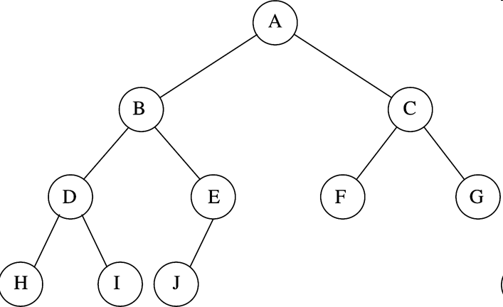
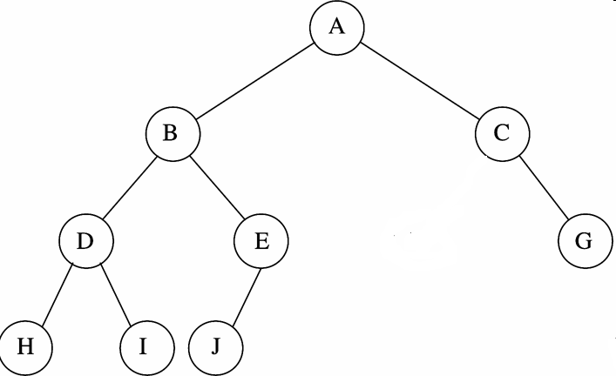
Heaps: complete vs Incomplete??

Slide 6
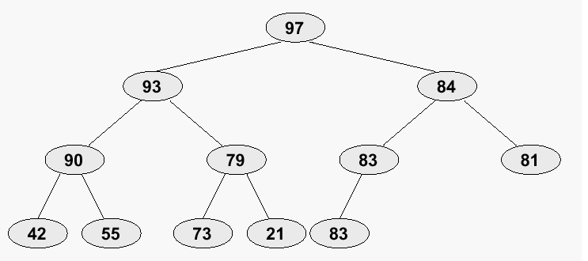
Heaps: an example

Slide 7

Heaps: using arrays
The Illustrated ‘Tree’ is in fact a logical Presentation
Because Heaps are Left-Adjusted Complete Binary trees, they are easily implemented using an Array
The number of nodes N in any Heap of hight h is:
    2^{h} ≤ N ≤2^{h+1} - 1
Implementation: How? For every element at index i:
  left child is at index 2i+1
  Right child is at index 2i+2
  parent is at index (i-1)/2
Illustration for the heap in previous slide

Slide 8
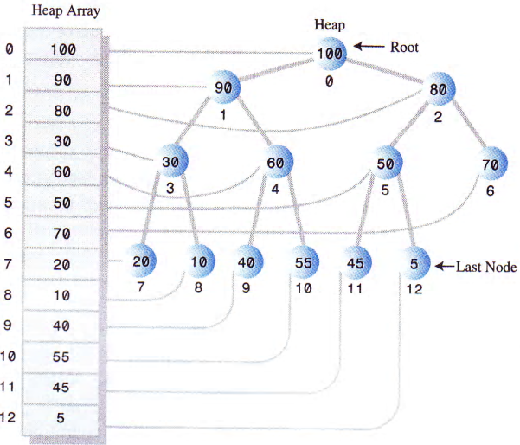
Heaps: using arrays, another example

Slide 9
Building a Heap from an Array:
Illustration
build_heap: Start with an arbitrary list, make it into a heap.
  Insert into a binary tree by level.
  For each node above the lowest level, percolate it up.
  When you reach the root, the tree is a heap.

Slide 10
Heap: an exercise
Try heaping:
10 12 1 14 6 5 8 15 3 9 7 4 11 13 18

Slide 11
Insert and delete an element from a heap

Slide 12
Heaps: Inserting a node
  point to the next empty location
    The right most leaf
  Insert the new element
  If the new element has bigger priority than the parent then swap it up till having a parent with greater priority OR till placed in the Root
  Refer to the next slide

Slide 13
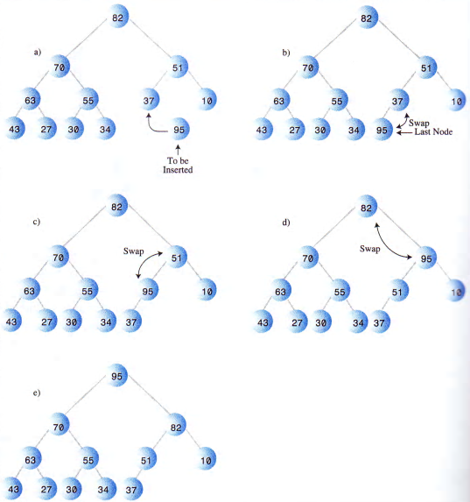
Heaps: Inserting a node

Slide 14
Heaps: Deleting a node
Get the element at the root
  The element with highest Priority is always at the Root
  (heapSize--)
Replace it with the last one
Adjust the heap

Slide 15
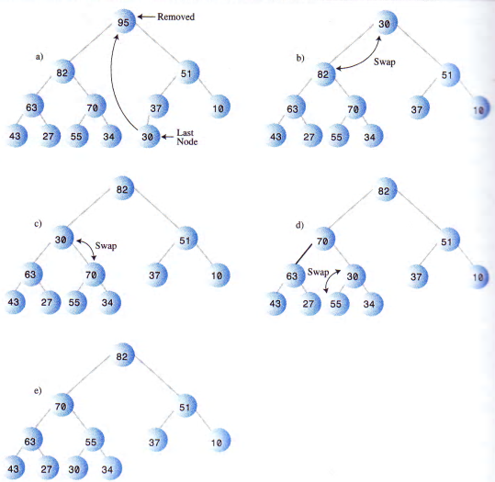
Heaps: removing the maximum node

Slide 16
Heaps: implementation of the operations

Slide 17
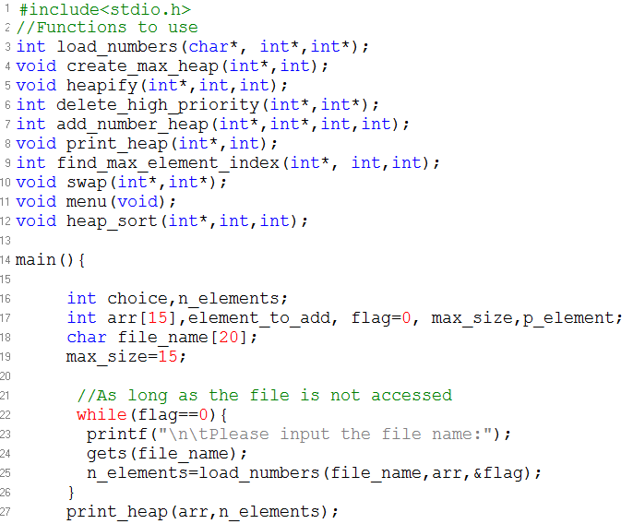
Create, Add, Delete, Sort: using a Heap

Slide 18
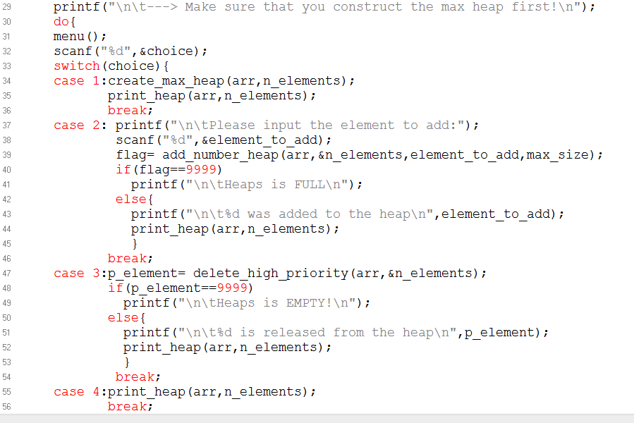

Slide 19
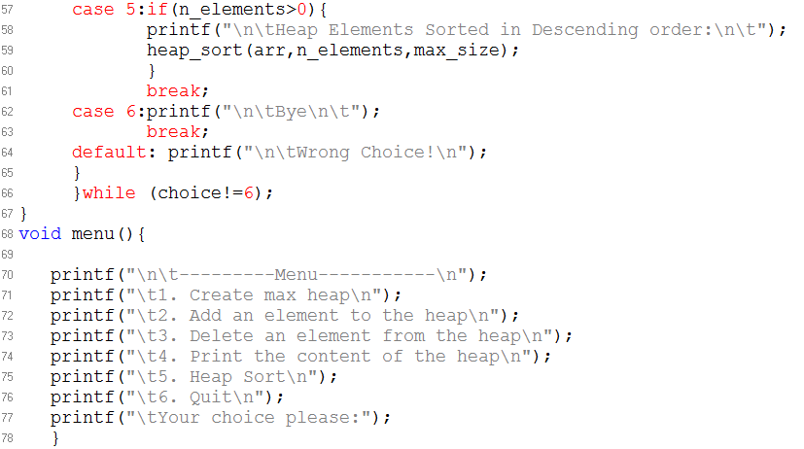
Menu to use:

Slide 20
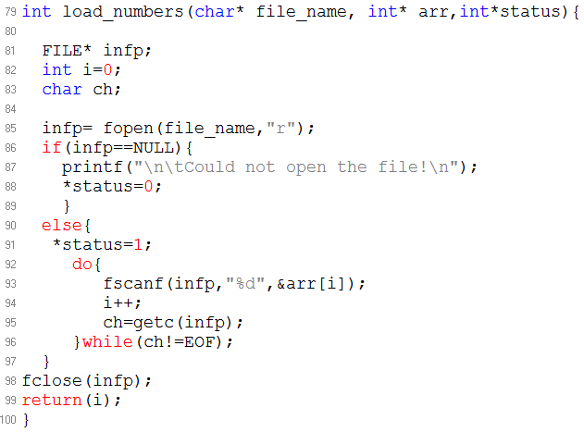
Load data from the file:

Slide 21
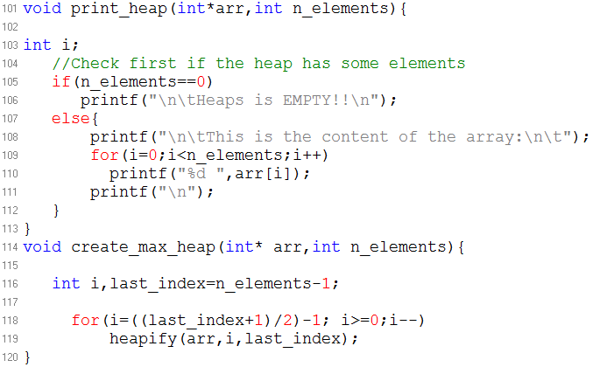
Print and Create Max Heap:

Slide 22
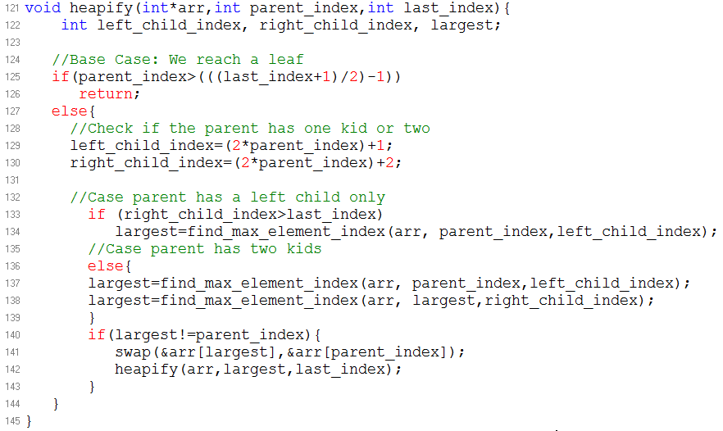
Heapify:

Slide 23
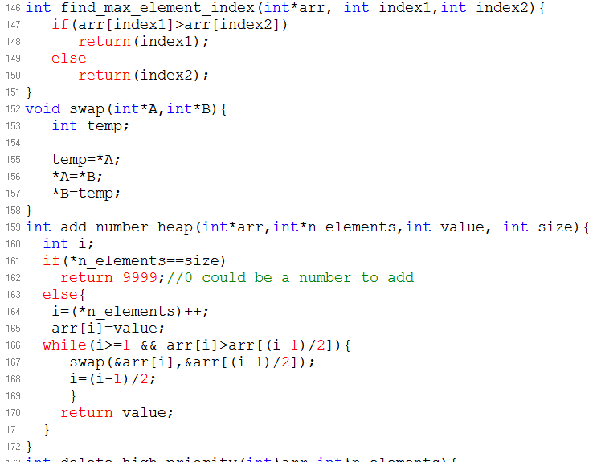
Find Max Element Index, Swap and Add:

Slide 24
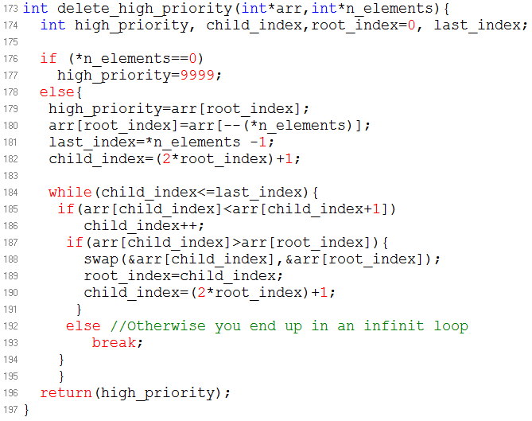
Delete:

Slide 25
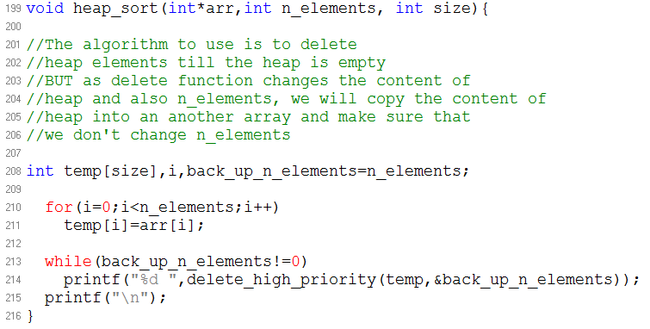
Heap Sort:

